Slide 1
String Matching

Slide 2
String Matching: Formal Definition
We assume that the text is an array T [1 . . n] of length n and that the pattern is an array P[1 . .m] of length m ≤ n.
We further assume that the elements of P and T are characters drawn from a finite alphabet .
For example, we may have∑ = {0,1} or ∑ = {a, b, . . . , z}. The character arrays P and T are often called strings of characters.

Slide 3
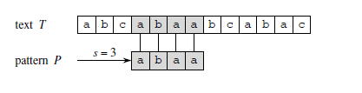
String Matching: Formal Definition
We say that pattern P occurs with shift s in text T (or, equivalently, that pattern P occurs beginning at position s + 1 in text T) if 0 ≤ s ≤ n − m and T [s + 1 . . s + m] = P[1 . .m] (that is, if T [s + j ] = P[ j ], for 1 ≤ j ≤ m).
If P occurs with shift s in T , then we call s a valid shift; otherwise, we call s an invalid shift.
The string-matching problem is the problem of finding all valid shifts with which a given pattern P occurs in a given text T .

Slide 4
Notation and terminology
Let ∑∗ (read “sigma-star”) denote the set of all finite-length strings formed using characters from the alphabet ∑ .
Here we consider only finite length strings. The zero-length empty string, denoted ε, also belongs to ∑∗.
The length of a string x is denoted |x|.
The concatenation of two strings x and y, denoted xy, has length |x| + |y| and consists of the characters from x followed by the characters from y.

Slide 5
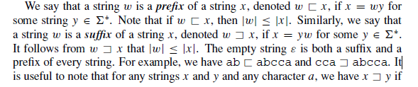
Notation and terminology

Slide 6

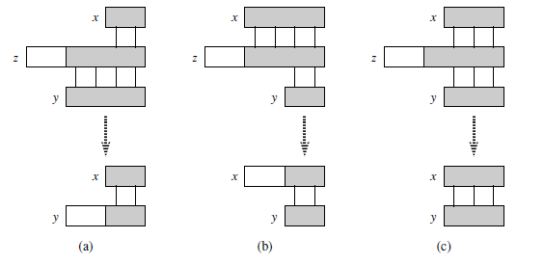

Slide 7
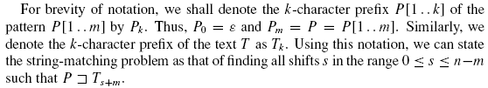


Slide 8
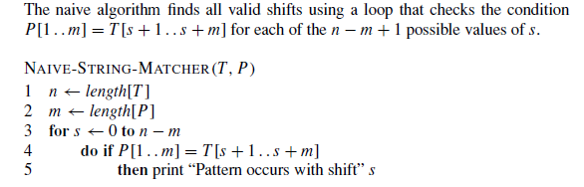
The naive string-matching algorithm

Slide 9
Algo analysis:
Procedure NAIVE-STRING-MATCHER takes time O((n − m + 1)m), and this bound is tight in the worst case.
For example, consider the text string a^{n} (a string of n a’s) and the pattern a^{m}.
For each of the n−m+1 possible values of the shift s, the implicit loop on line 4 to compare corresponding characters must execute m times to validate the shift.
The worst-case running time is thus ((n − m + 1)m), which is (n²) if m = n/2.
The running time of NAIVE-STRING-MATCHER is equal to its matching time, since there is no preprocessing.

Slide 10
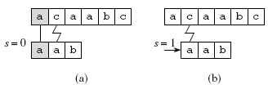
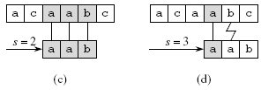
Example:
The operation of the naive string matcher for the pattern P = aab and the text T = acaabc.
One occurrence of the pattern is found, at shift s = 2, shown in
part (c)

Slide 11
The Rabin-Karp algorithm
The Rabin-Karp algorithm uses Θ(m) preprocessing time, and its worst-case running time is Θ((n−m+1)m). Based on certain assumptions, however, its average-case running time is better.
Let us assume that Σ= {0, 1, 2, . . . , 9}, so that each character is a decimal digit. (In the general case, we can assume that each character is a digit in radix-d notation, where d = | Σ |.)
We can then view a string of k consecutive characters as representing a length-k decimal number. The character string 31415 thus corresponds to the decimal number 31,415.

Slide 12
The Rabin-Karp algorithm
Given a pattern P[1 . .m], we let p denote its corresponding decimal value.
In a similar manner, given a text T [1 . . n], we let t_{s} denote the decimal value of the length-m substring T [s + 1 . . s + m], for s = 0, 1, . . . , n − m.
Certainly, t_{s} = p iff T [s + 1 . . s + m] = P[1 . .m];
thus, s is a valid shift if and only if t_{s} = p.
If we could compute p in time Θ(m) and all the t_{s} values in a total of Θ(n − m + 1) time then we could determine all valid shifts s in time Θ(m) + Θ(n − m + 1) = Θ(n) by comparing p with each of the t_{s}’s.

Slide 13
The Rabin-Karp algorithm
We can compute p in time Θ (m) using Horner’s rule
p = P[m] + 10 (P[m − 1] + 10(P[m − 2]+· · ·+10(P[2] + 10P[1]) · · ·)) .
The value t0 can be similarly computed from T [1 . . m] in time Θ(m).
To compute the remaining values t1, t2, . . . , tn−m in time Θ(n−m), it suffices to observe that ts+1 can be computed from ts in constant time, since
ts+1 = 10(ts − 10^{m−1}T [s + 1]) + T [s + m + 1]

Slide 14
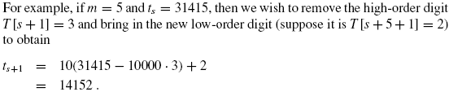
Subtracting 10^{m−1}T [s +1] removes the high-order digit from t_{s} ,
multiplying the result by 10 shifts the number left one position,
and adding T [s +m +1] brings in the appropriate low-order digit.

Slide 15
The Rabin-Karp algorithm
Thus, we can compute p in time Θ(m) and compute t₀, t₁, . . . , t_{n−m} in time Θ(n − m + 1).
We can find all occurrences of the pattern P[1 . .m] in the text T [1 . . n] with Θ(m) preprocessing time and Θ(n − m + 1) matching time.
The only difficulty with this procedure is that p and t_{s} may be too large to work with conveniently.
If P contains m characters, then assuming that each arithmetic operation on p (which is m digits long) takes “constant time” is unreasonable.

Slide 16
The Rabin-Karp algorithm
Fortunately, there is a simple cure for above problem
Compute p and the t_{s} ’s modulo a suitable modulus q.
Since the computation of p, t₀, and
ts+1 = 10(ts − 10^{m−1}T [s + 1]) + T [s + m + 1] can all be performed modulo q, we see that we can compute p modulo q in Θ(m) time and all the ts’s modulo q in Θ(n − m + 1) time.
It becomes
t_{s+1} = (d(t_{s} − T [s + 1]h) + T [s + m + 1]) mod q ,
where h ≡ d^{m−1} (mod q) is the value of the digit “1” in the high-order position of an m-digit text window.

Slide 17
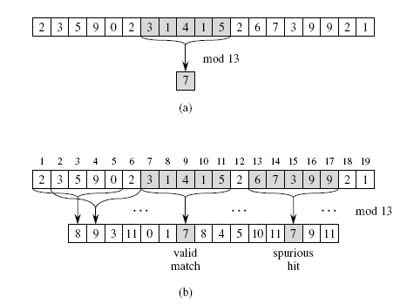

Slide 18
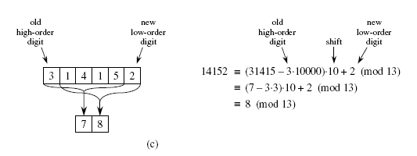

Slide 19
The Rabin-Karp algorithm
The solution of working modulo q is not perfect, however, since t_{s} ≡ p (mod q) does not imply that t_{s} = p.
On the other hand, if t_{s} ≠p (mod q), then we definitely have that t_{s} ≠ p, so that shift s is invalid.
We can thus use the test t_{s} ≡ p (mod q) as a fast heuristic test to rule out invalid shifts s.
Any shift s for which t_{s} ≡ p (mod q) must be tested further to see if s is really valid or we just have a spurious hit.
This testing can be done by explicitly checking the condition
P[1 . .m] = T [s + 1 . . s + m]. If q is large enough, then we can hope that spurious hits occur infrequently enough that the cost of the extra checking is low

Slide 20
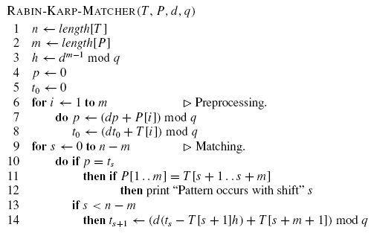
Algorithm: The inputs to the procedure are the text T , the pattern P, the radix d to use (which is typically taken to be | Σ |),and the prime q to use.

Slide 21
Running time
RABIN-KARP-MATCHER takes Θ(m) preprocessing time, and its matching time is Θ((n − m + 1)m) in the worst case, since (like the naive string-matching algorithm) the Rabin-Karp algorithm explicitly verifies every valid shift.
In many applications, we expect few valid shifts (perhaps some constant c of them); in these applications, the expected matching time of the algorithm is only
O((n − m + 1) + cm) = O(n+m)

Slide 22
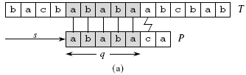
The Knuth-Morris-Pratt algorithm
Here we use the prefix function π for a pattern that encapsulates knowledge about how the pattern matches against shifts of itself.
Above information can be used to avoid testing useless shifts in the naive pattern-matching algorithm.
Figure shows a particular shift s of a template containing the pattern
P = ababaca against a text T .
For this example, q = 5 of the characters have matched successfully, but the 6th pattern character fails to match the corresponding text character. The information that q characters have matched successfully determines the corresponding text characters.

Slide 23
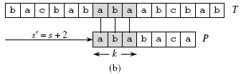
The Knuth-Morris-Pratt algorithm
In the example of the figure, the shift s + 1 is necessarily invalid, since the first pattern character (a) would be aligned with a text character that is known to match with the second pattern character (b).
The shift s = s + 2 shown in part (b) of the figure, however, aligns the first three pattern characters with three text characters that must necessarily match.

Slide 24
The Knuth-Morris-Pratt algorithm
In general, it is useful to know the answer to the following question:
Given that pattern characters P[1 . . q] match text characters T [s+1 . . s+q], what is the least shift s’ > s such that
P[1 . . k] = T [s’ + 1 . . s’ + k] ,
where s’ + k = s + q?
Such a shift s is the first shift greater than s that is not necessarily invalid due to our knowledge of T [s +1 . . s+q].
In the best case, we have that s’ = s+q, and shifts s + 1, s + 2, . . . , s + q − 1 are all immediately ruled out.
In any case, at the new shift s’ we don’t need to compare the first k characters of P with the corresponding characters of T , since we are guaranteed that they match by above equation.

Slide 25

The Knuth-Morris-Pratt algorithm
The necessary information can be precomputed by comparing the pattern against itself, as illustrated in Figure
Since T [s’ +1 . . S’ +k] is part of the known portion of the text, it is a suffix of the string Pq .
Equation P[1 . . k] = T [s’ + 1 . . s’ + k] can therefore be
interpreted as asking for the largest k < q such that
Pk ב Pq . Then, s’ = s+(q−k) is the next potentially valid shift.

Slide 26
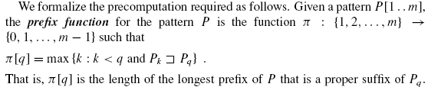
The Knuth-Morris-Pratt algorithm:
Precomputation

Slide 27

The Knuth-Morris-Pratt algorithm:
Precomputation
Following Figure gives the complete prefix function π for the pattern ababababca.

Slide 28
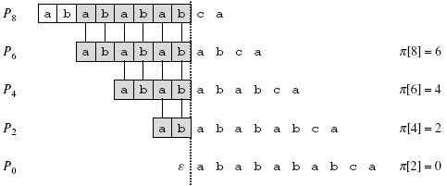
The Knuth-Morris-Pratt algorithm:
Precomputation
Following Figure gives the complete prefix function π for the pattern ababababca.

Slide 29
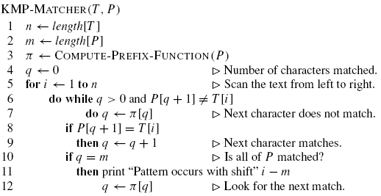
The Knuth-Morris-Pratt algorithm:

Slide 30
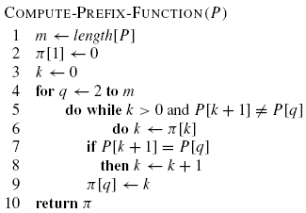
The Knuth-Morris-Pratt algorithm:

Slide 31
The Knuth-Morris-Pratt algorithm:

Slide 32
Horspool’s Algorithm
This algorithm is simplified version Boyer Moore algorithm.
In this algorithm comparisons of characters are done from right to left.
This algorithm determines the size of the shift by looking at the character c of the text that is aligned against the last character of the pattern.

Slide 33
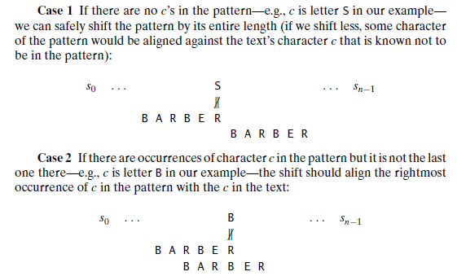
Four Possibilities

Slide 34
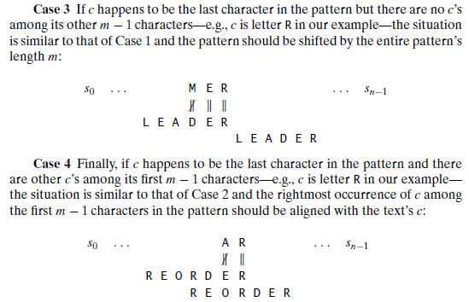
Four Possibilities…

Slide 35
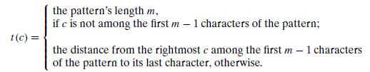
Shift Table (or Bad Match table)
We can pre compute shift sizes and store them in a table.
The table will be indexed by all possible characters that can be encountered in a text.
The table’s entries will indicate the shift sizes computed by the formula

Slide 36
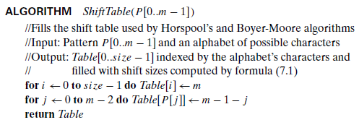
Algorithm for the Shift table

Slide 37
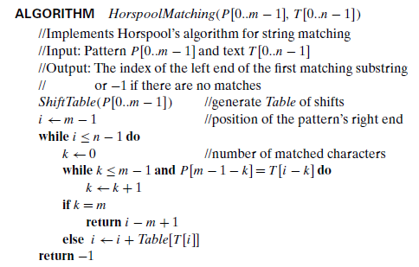
Horspool Matching Algorithm

Slide 38
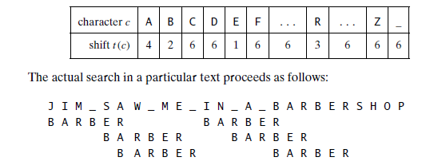
Example

Slide 39
Example
Consider the text: WELCOMETOTEAMMAST
And Pattern: TEAMMAST

Slide 40
Boyer Moore Algorithm
Boyer-Moore algorithm determines the shift size by considering two quantities.
The first one is guided by the text’s character c that caused a mismatch with its counterpart in the pattern. Accordingly, it is called the bad symbol shift.
The second type of shift is guided by a successful match of the last k > 0 characters of the pattern. we call this type of shift the good-suffix shift.

Slide 41
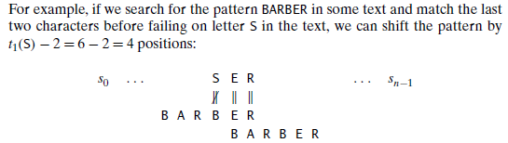
Bad Symbol Shift
The size of bad symbol shift can be computed by the formula t1(c) − k
Where t1(c) is the entry in the precomputed table used by Horspool’s algorithm and k is the number of matched characters:

Slide 42
Bad Symbol Shift
the bad-symbol shift d1 is computed by the Boyer-Moore algorithm either as
t1(c) − k if this quantity is positive and as 1 if it is negative or zero. This can be expressed by the following compact formula: d1 = max{t1(c) − k, 1}.

Slide 43

Good Suffix Shift
The second type of shift is guided by a successful match of the last k > 0 characters of the pattern.
We refer to the ending portion of the pattern as its suffix of size k and denote it suff (k).
When there is another occurrence of suff (k) not preceded by the same character as in its rightmost occurrence. We can shift the pattern by the distance d2 between such a second rightmost occurrence
for the pattern ABCBAB, these distances for k = 1 and 2 will be 2 and 4, respectively:

Slide 44
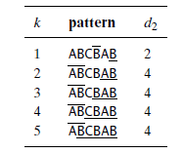
Good Suffix Shift
If there is no other occurrence of suff(k) in the pattern not preceded by the same character as in its rightmost occurrence, we need to find the longest prefix of size l < k that matches the suffix of the same size l.
If such a prefix exists, the shift size d2 is computed as the distance between this prefix and the corresponding suffix; otherwise, d2 is set to the pattern’s length m.
As an example, here is the complete list of the d2 values—the good-suffix table of the Boyer-Moore algorithm—for the pattern ABCBAB:

Slide 45

Boyer Moore Algorithm
Step1: For a given pattern and the alphabet used in both the pattern and the text, construct the bad-symbol shift table
Step2: Using the pattern, construct the good-suffix shift table
Step4: Align the pattern against the beginning of the text.
Step5:Repeat the following step until either a matching substring is found or the pattern reaches beyond the last character of the text
    Starting with the last character in the pattern, compare the corresponding characters in the pattern and the text until either all m character pairs are matched (then stop) or a mismatching pair is encountered after k ≥ 0 character pairs are matched successfully.
    In the latter case, retrieve the entry t1(c) from the c’s column of the bad-symbol table where c is the text’s mismatched character.
    If k > 0, also retrieve the corresponding d2 entry from the good-suffix table. Shift the pattern to the right by the number of positions computed by the formula

Slide 46
Example
Text: BESS_KNEW_ABOUT_BAOBABS
Pattern: BAOBAB

Slide 47
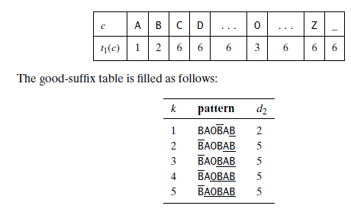
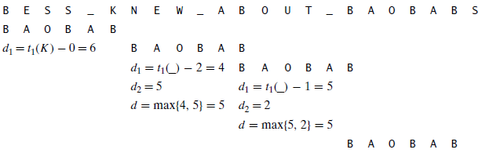
Solution

Slide 48
String matching with finite automata
These string-matching automata are very efficient: they examine each text character exactly once, taking constant time per text character.
The matching time used—after preprocessing the pattern to build the automaton—is therefore (n).
The time to build the automaton, however, can be large if is large.

Slide 49
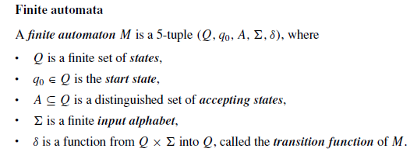
Finite automata

Slide 50
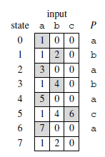
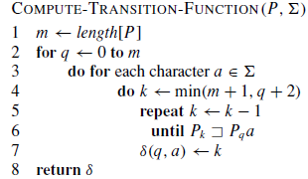
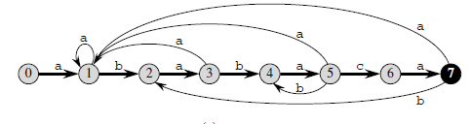
Computation of Transition function

Slide 51
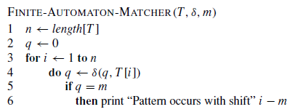

Matching of Pattern with Text

